Slide 1
Santa_ Diary_
My Mad-107 project

Slide 2
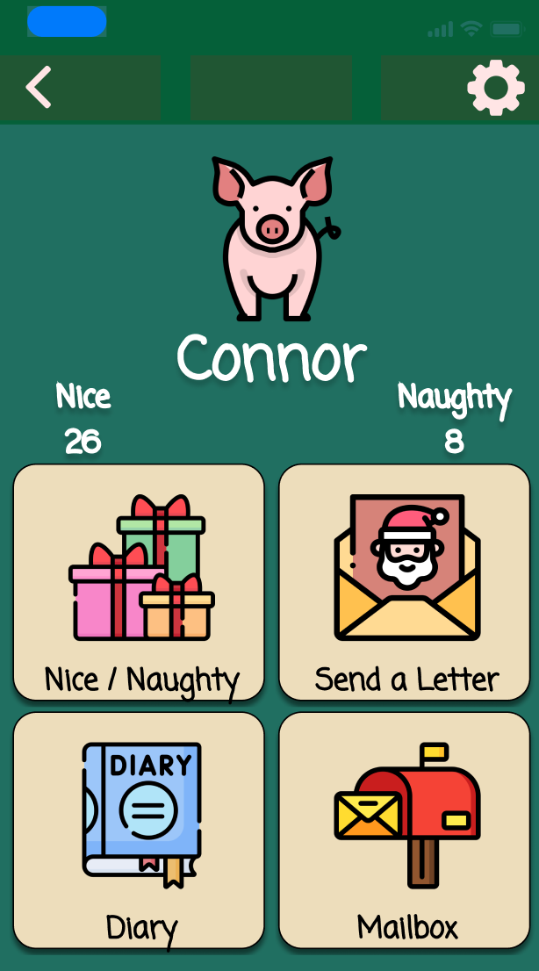
What’s the end goal?

Slide 3
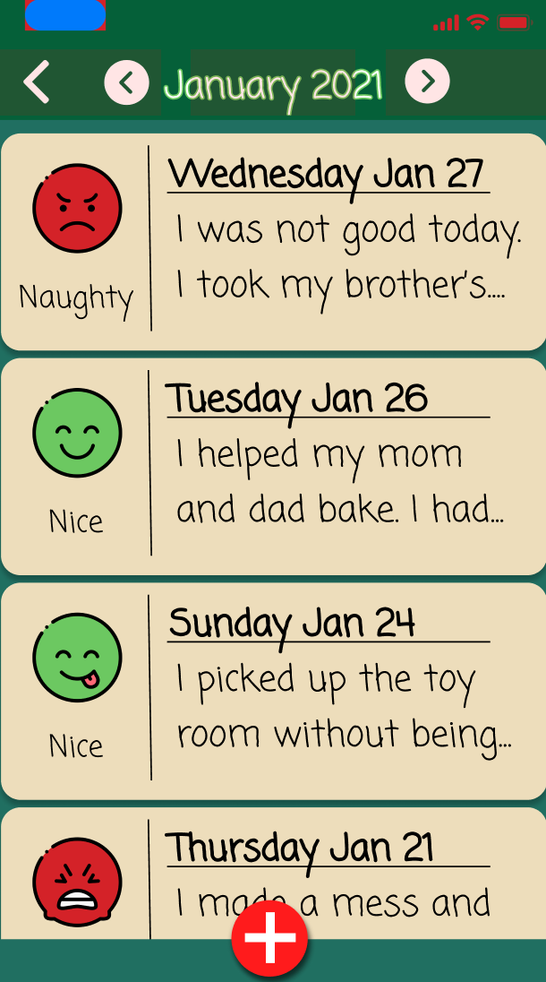
View Diary entries

Slide 4
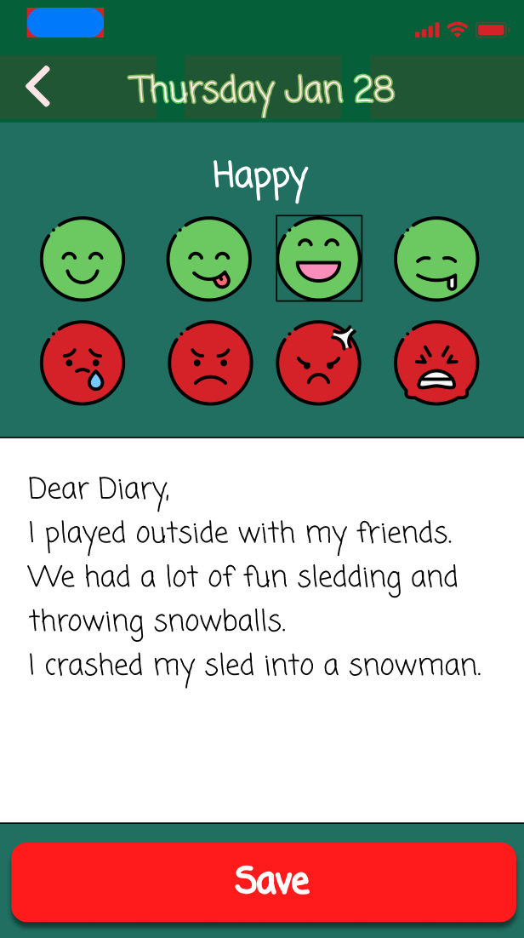
Add Diary entries

Slide 5
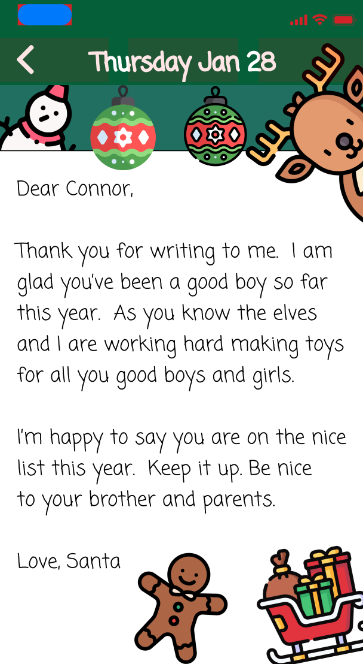
Read and write letters to santa

Slide 6
So what’s the plan?
Start with the diary entries

Slide 7
How to organize the data
Figure out what type of data I need to collect
Need to play around with how I want to organize the data
What type of functions will I need?

Slide 8

Work on file structure
Connor
Settings
Diary
Letters
Users
Landon

Slide 9
Read, Write, and Delete data
Learn and use Apple’s FileManager to read, write, and delete text files
Simulate data storage
All saved in the documents folder on my computer.

Slide 10
Write classes and structs
These will handle all the data storage functions
User will enter text and DiaryManager will handle the organization and storing the data.
DiaryManager().addEntry(text: String)

Slide 11
The output
The user will want to read old entries or letters
Write the functions used to sort through data and print to the console
Example: DiaryManager().displayEntry(year: String, Month: String,day)

Slide 12
A search feature?
User may want to view entries from a different time period
Write the functions used to sort through data and print all relevant data to console.
Example:
DiaryManager().getEntries(year: String, Month: String)

Slide 13
Future
Write similar classes, structs, and functions for the santa letters
Learn about json files and if they would be better suited for simulating a database

